Slide 1
CAP-DS-05|SQL Mini Project L1
By-Harshita Singh
cds05_109

Slide 2
Introduction
Here are some key columns:
name: Car's Name
year: Car's manufacturing year.
selling_price: Price at which the car was sold.
km_driven: Total kilometres the car has been driven.
fuel: Type of fuel the car uses- Petrol, LPG, Diesel, CNG.
seller_type: Seller type - individual, dealer, or Trustmark dealer.
transmission: Gear-shifting method - manual or automatic.
owner: Number of previous owners.
mileage: Kilometres per litre the car can travel.
engine _CC: Engine size in cubic centimetres.
max_power: Maximum power output of the engine.
seats: Number of seating positions in the car.
Notes:
fuel- there are 4 varieties in it Petrol,LPG,Diesel,CNG;
seller_type i.e.,Classifying sellers into individual, dealer, or Trustmark dealer categories.;
transmission: the method through which power is transferred - manual or automatic;

Slide 3
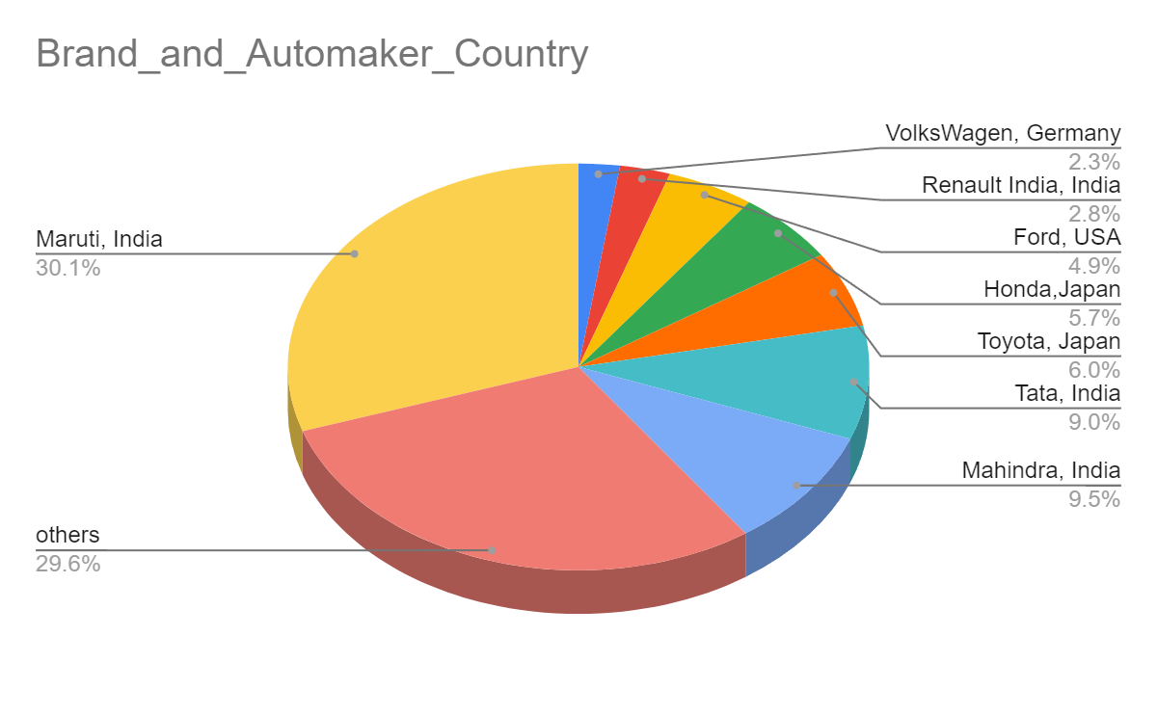
Percentage Of Cars & Their Automaker Country

Slide 4
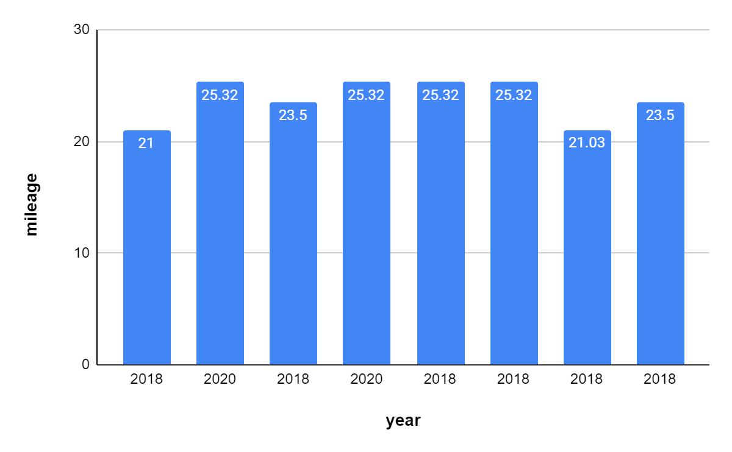








Mahindra Cars, their Manufacturing Year & Mileage
Year:2018 & Beyond, Mileage:20+

Slide 5
Percentage of Cars Sold by Seller Type
seller_type | Percentage_sold | No. Of Cars sold
Individual | 83.2431 | 6766
Dealer | 13.8533 | 1126
Trustmark Dealer | 2.9035 | 236

Slide 6
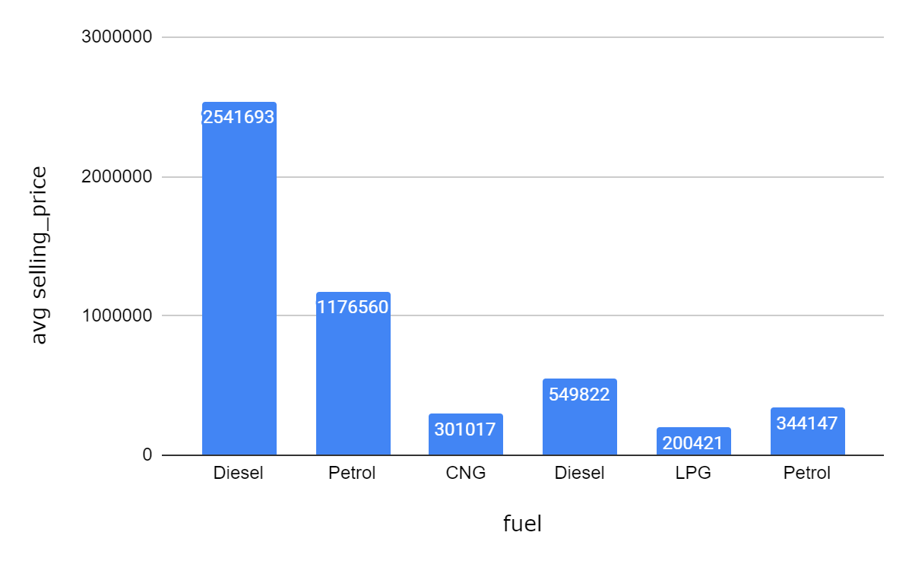
Average Selling Price Analysis
Average Selling Price by Fuel and Transmission
AUTOMATIC
AUTOMATIC
MANUAL
MANUAL
MANUAL
MANUAL

Slide 7
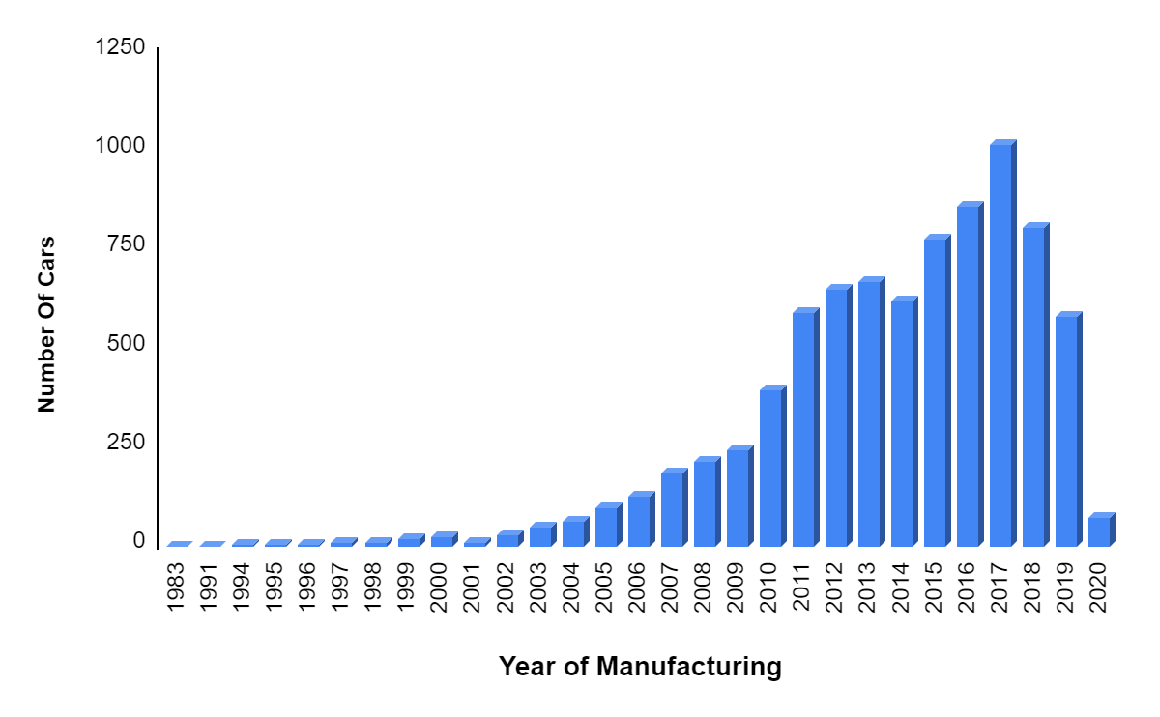
Cars Manufactured Per Year
Year | No. Of Cars | Year | No. Of Cars
1983 | 1 | 2006 | 124
1991 | 1 | 2007 | 183
1994 | 3 | 2008 | 214
1995 | 2 | 2009 | 246
1996 | 3 | 2010 | 394
1997 | 11 | 2011 | 592
1998 | 10 | 2012 | 651
1999 | 18 | 2013 | 670
2000 | 22 | 2014 | 621
2001 | 10 | 2015 | 776
2002 | 27 | 2016 | 859
2003 | 49 | 2017 | 1018
2004 | 62 | 2018 | 807
2005 | 97 | 2019 | 583
 |  | 2020 | 74

Slide 8
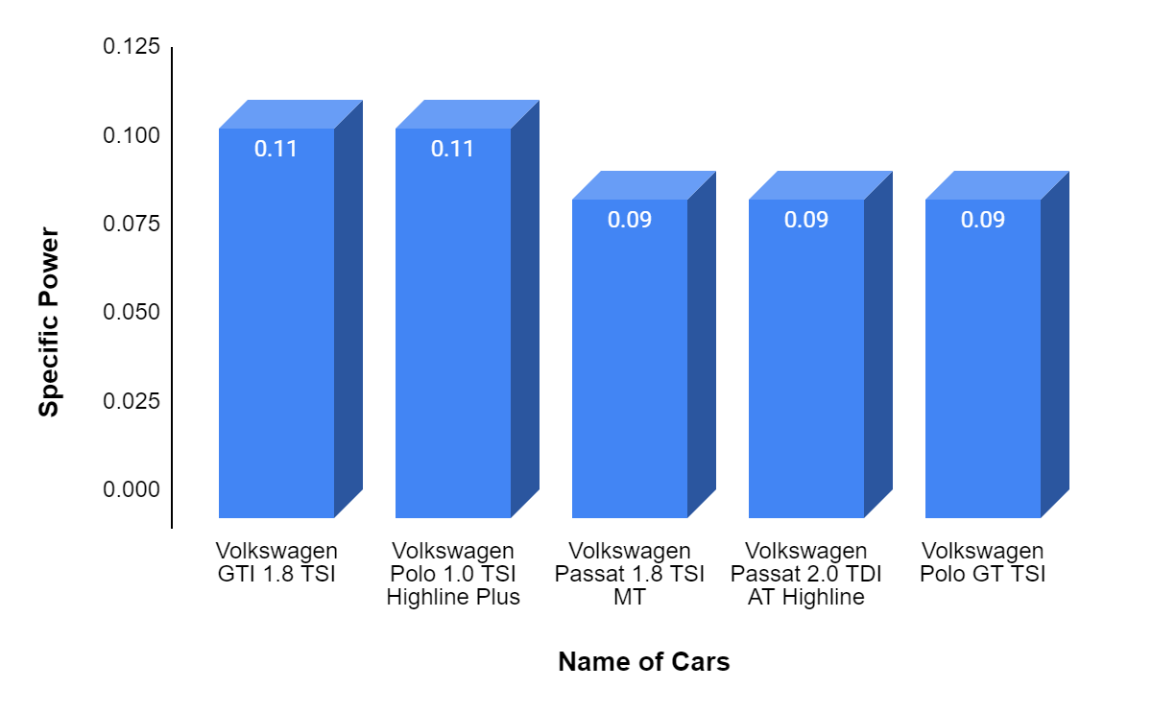

Volkswagen Specific Power Analysis
Top 5 Cars

Slide 9
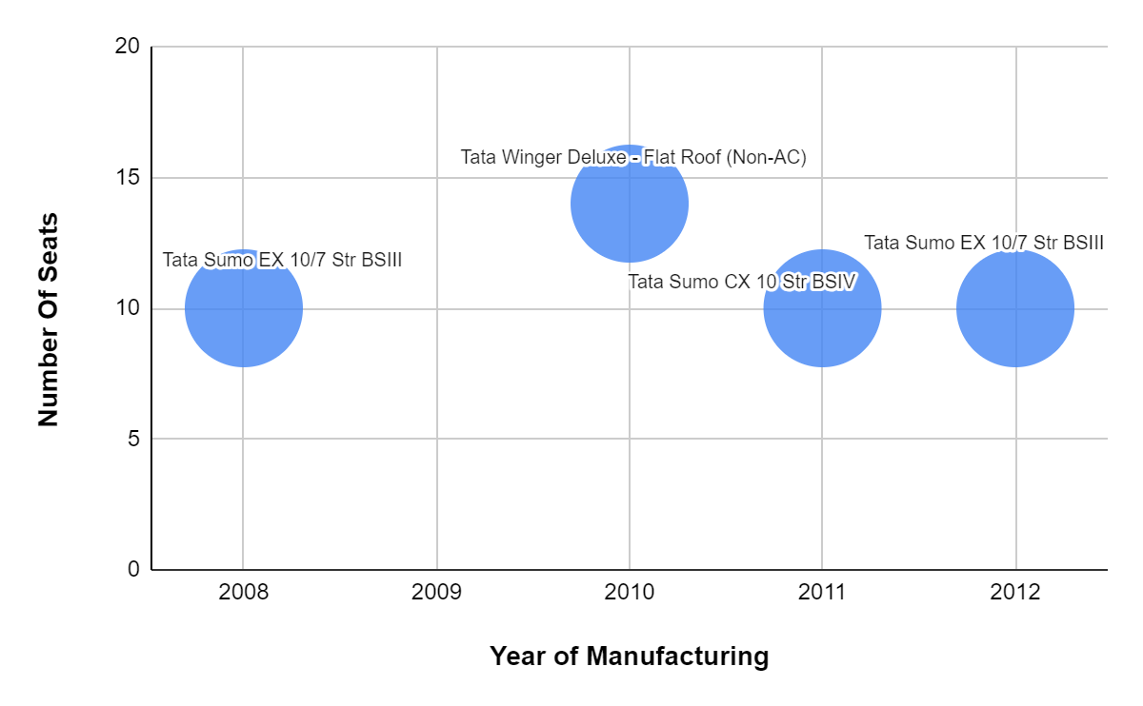
Tata Car Seat Selection
Filtering Tata Cars with 14 or 10 Seats

Slide 10
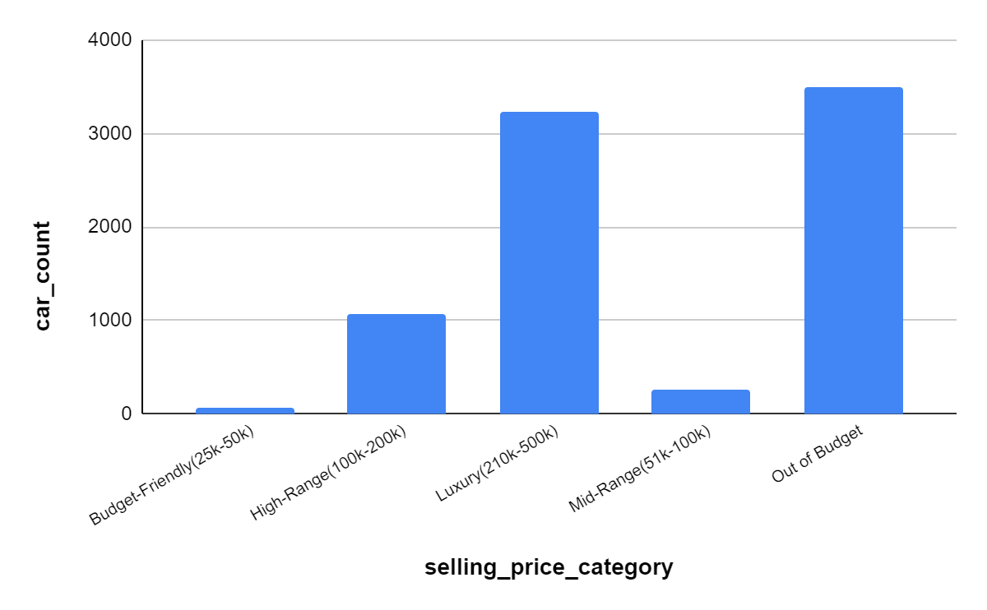
Selling Price Categories and Average Mileage Analysis
selling_price_category | car_count | avg_mileage
Budget-Friendly(25k-50k) | 71 | 17
High-Range(100k-200k) | 1062 | 18
Luxury(210k-500k) | 3231 | 20
Mid-Range(51k-100k) | 257 | 18
Out of Budget | 3507 | 19

Slide 11
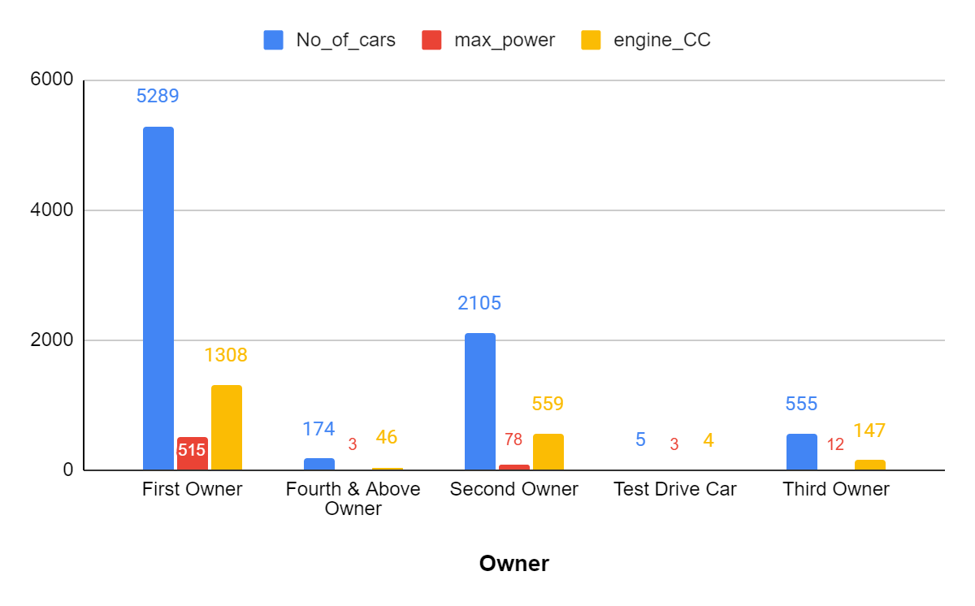
Distribution of Cars by Owners and Power/Engine Categories
Counting Cars with Max Power ≥ 150 and Engine CC ≥ 1500 by Owner

Slide 12
Conclusion
Maruti’s Dominance
Seller Dynamics: Individual sellers leading the market.
Pricing Insights: LPG-manual pair.
Manufacturing year analysis: 2017.
Tata's Diversity
Market leans towards the 'Out of Budget' segment.
Ownership Dynamics: First owners dominate.

Slide 13


